Slide 1
Security and Building for Production

Slide 2
Chrome Developer Tools and Security
Security and the eval() Function Preventing Man-in-the-middle Attacks Cross-site Scripting (XSS)
Introduction
Building Your Application for Production

Slide 3
Chrome Developer Tools and Security

Slide 4



Application Data Security
Don't store passwords, secrets or other sensitive information
Don't use global variables
Assume hackers can read your JS code and access all data sent to a browser

Slide 5
Security and the eval() Function

Slide 6
Preventing Man-in-the-middle Attacks

Slide 7
<script>…</script>

Slide 8



Prevent Man-in-the-middle Attacks
Use SSL
Use HTTP Header: Strict-Transport-Security
Use cookie attributes: Secure and HttpOnly

Slide 9
Cross-site Scripting (XSS)

Slide 10

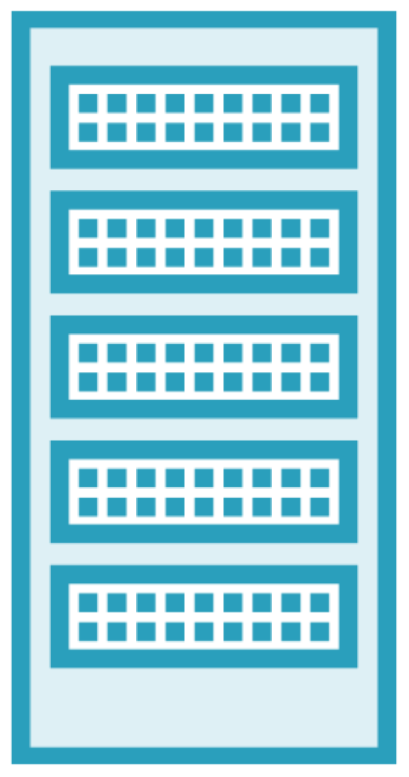




Cross-site Scripting (XSS)
3rd Party Server

Slide 11
Addressing Cross-site Scripting Attacks
CSP:
Content Security Policy
Use HTTP Header: Content-Security-Policy
CORS:
Cross Origin Resource Sharing
Use HTTP Header: Access-Control-Allow-Origin

Slide 12
Building Your Application for Production

Slide 13

Chrome Developer Tools and Security
All your code and data is exposed
Avoid JS's eval() Function
Preventing Man-in-the-middle Attacks
Use SSL related mechanisms
XSS
Building for Production
npm run build
/build folder
Summary

